Slide 1
Breast cancer Prediction
Submitted by :-
Gaurav Dhamija

Slide 2
Contents
Importing the libraries
Loading the data
Data manipulation
Creating the DataFrame
Data Visualization
Splitting DataFrame in Train and Test
Feature Scaling
Machine Learning Model Building
Models used

Slide 3
Libraries
Pandas
Numpy
Matplotlib
Seaborn
Scikit learn
Statsmodels

Slide 5
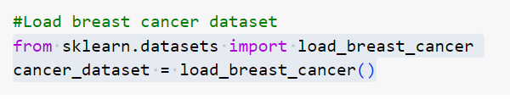
Data Loading
It is the data that we need to load for starting any of the ML project.

Slide 6
Data Manipulation
Data manipulation refers to the process of altering, modifying, or transforming data to extract meaningful insights, improve data quality, or prepare it for specific analysis or reporting purposes.
It includes various process which is shown further slide.

Slide 7
Data cleaning
Data transformation
Data filtering
Data aggregation
Data merging
Data normalization
Data reshaping
Data sampling
:

Slide 8
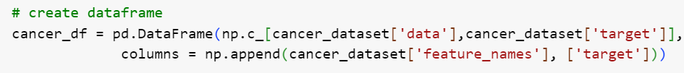
Create DataFrame
A DataFrame is a data structure that organizes data into a 2-dimensional table of rows and columns, much like a spreadsheet.

Slide 9
Data Visualization
Data visualization is the graphical representation of data and information to present complex datasets in a more accessible and understandable form.
The main goal of data visualization is to visually
communicate insights, patterns, and trends that might not be easily apparent when examining raw data alone.
By using visual elements like charts, graphs,maps, and other graphical representations, data visualization helps users interpret and draw meaningful conclusions from data quickly and effectively.

Slide 10
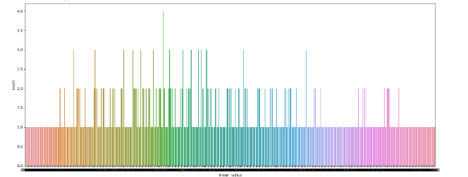
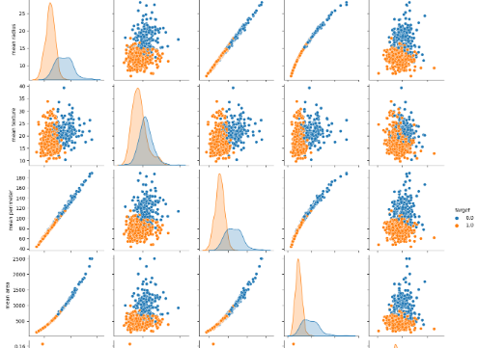
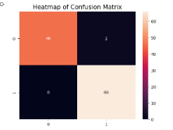
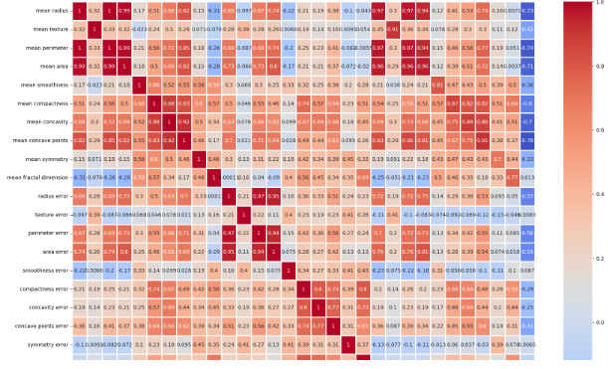

Slide 11
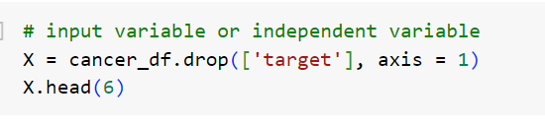
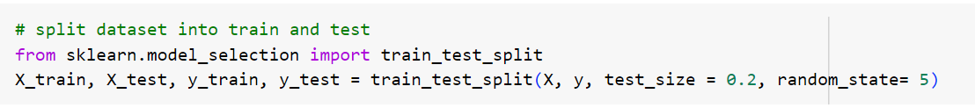
Splitting DataFrame in Train and Test

Slide 12
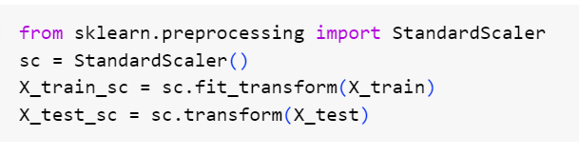
Feature Scaling
Feature scaling is the process of normalizing
the range of features in a dataset.

Slide 13
ML model building
Building a model in machine learning is creating a mathematical representation by generalizing and learning from training data.
Then, the built machine learning model is applied to new data to make predictions and obtain results.

Slide 14
Models used
Suppor vector Classifier
Logistic Regression
K – Nearest Neighbour Classifier
Naive Bayes Classifier
Decision Tree Classifier
Random Forest Classifier
AdaBoost Classifier
XGBoost Classifier

Slide 15
Accuracy
Models | Accuracy ( in % )
Support Vector classifier | 96
Logistic regression | 45
K-Nearest neighbour classifier | 57
Naïve Bayes classifier | 93
Decision Tree classifier | 75
Random Forest classifier | 75
Adaboost classifier , Xgboost classifier | 94 , 98

Slide 16
Conclusion
The Xgboost classifier model gives
best accuracy among all the models which
is : 0.9824561403508771.
Or
in Percentage we can say 98%.

Slide 17


